Slide 1
Presentation on Project Report
Library Management System
Submitted To :
A. S. M Delwar Hossain
Teaching Assistant
Computer Science & Engineering,
Varendra University.
Submitted By :
Abdullah Al Mamun Tonmoy
ID:171311010
Dept. Of CSE,
Varendra University.

Slide 2
Content
Introduction
Purpose
Increment tools
Developing screen shot
Conclusion

Slide 3
Introduction
The project “Library Management System” is developed in Java, which mainly focuses on basic operations in a library like adding new books, and updating new information, searching books and members and return books
This project of “Library Management System” of gives us the complete information about the library, We can enter the record of new books and retrieve the details of books available in the library, We can issue the books to the students and maintain their records and can also check how many books are issued and stock available in the library. The project is very useful for those who want to know about Library Management System

Slide 4
Purpose
Management software for monitoring and controlling the transactions in a library
Add, modify and delete book details into the database.
Search feature for finding book availability in library stock.
Add students records upon issue of a book.

Slide 5
Increment Tools
JVM
NetBeans
XAMPP Server
Browser

Slide 6
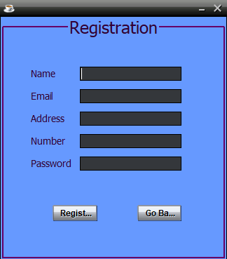

Slide 7
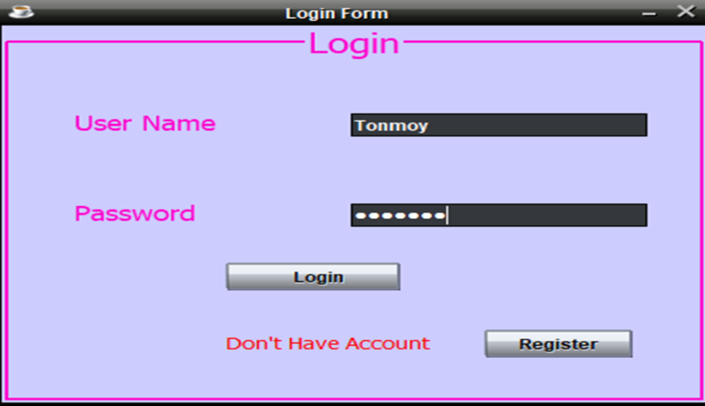

Slide 8
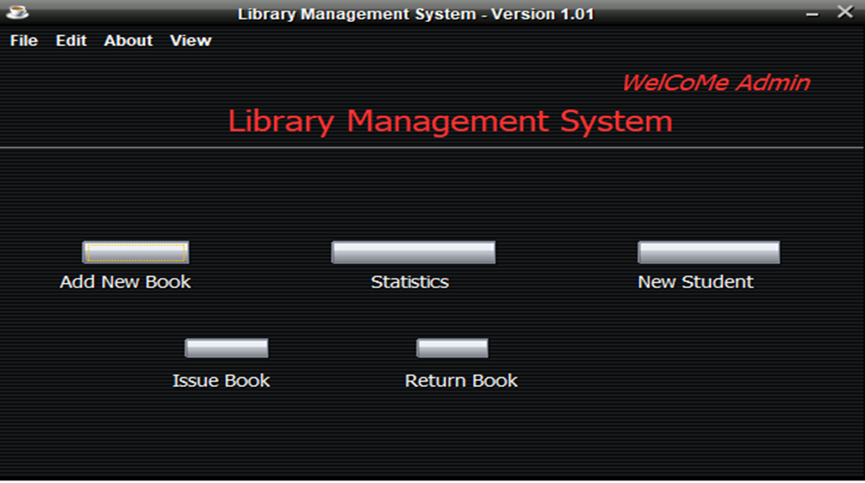

Slide 9
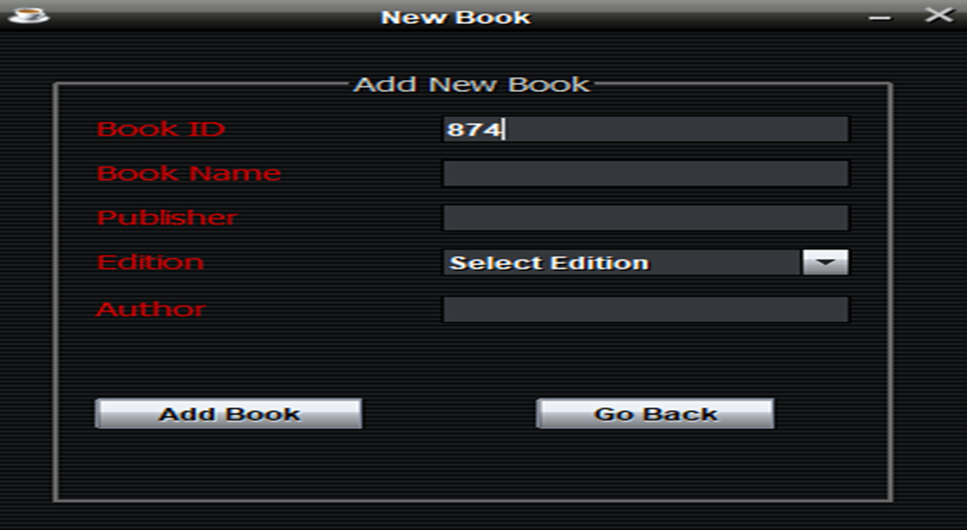

Slide 10
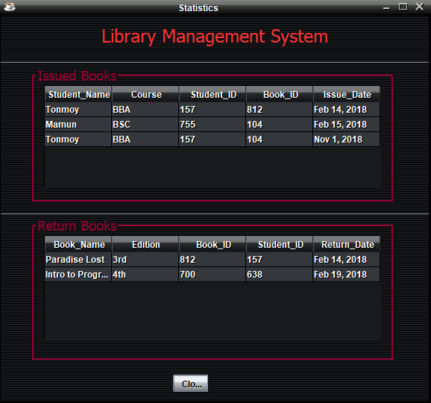

Slide 11
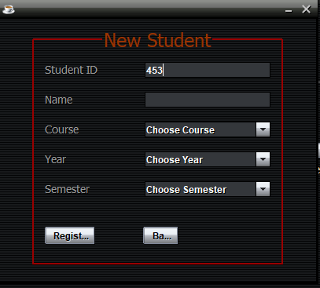

Slide 12
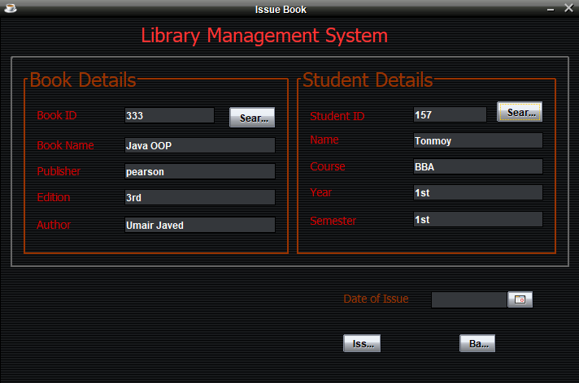

Slide 13
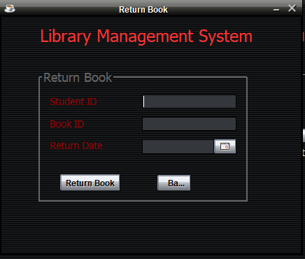

Slide 14
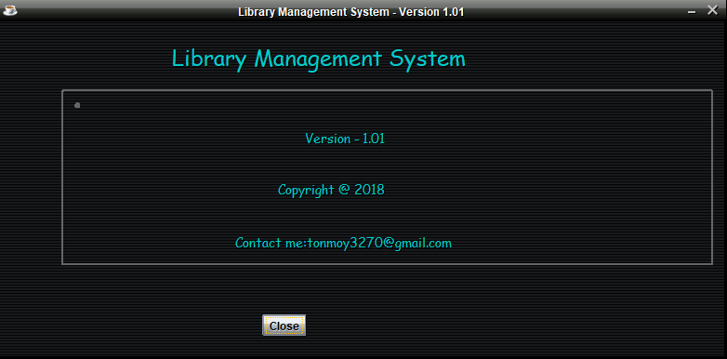

Slide 15
Conclusion
The library management system meets the current requirements of users of a typical library, but many new features and enhancements can be added into the system as per user requirements. Some of these include developing system using RFID, adding SMS module, sending SMS to check book availability, etc.

